Slide 1
DATA-PROCESSING CIRCUITS
4
LEACH, MALVINO & SAHA

Slide 2
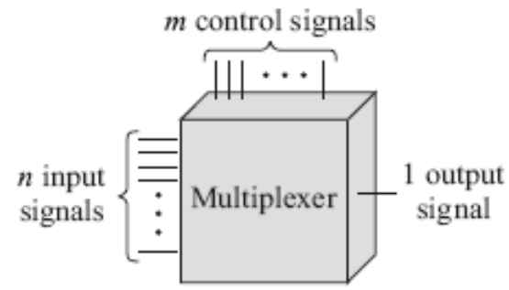

Multiplexers
Objective:
  Multiplexer means many into one. A multiplexer is a circuit with many inputs but only one output.
  The 74150
  Multiplexer Logic
  Bubbles on Signal Lines
  Universal logic circuit

Slide 3
Concept
Multiplexer is also called a data selector and control inputs are termed select inputs.
The circuit has n input signals, m control signals and 1 output signal. Note that, m control signals can select at the most 2^{m} input signals thus n <2^{m}

Slide 4
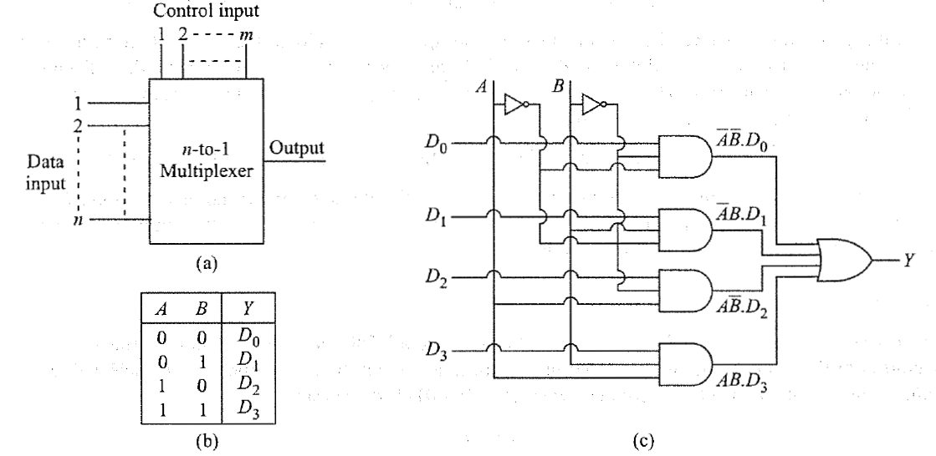
|Block Diagram

Slide 5
Commercial Multiplexer
Commercial multiplexers ICs come in integer power of 2
Example: 2-to-1, 4-to-1, 8-to- l, 16-to-l multiplexers.

Slide 6
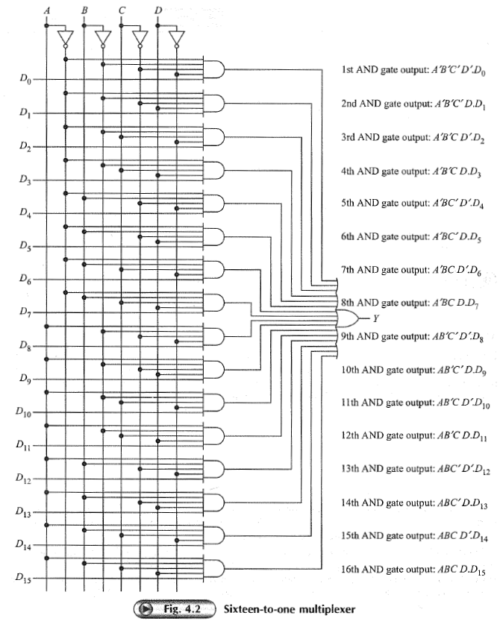
74150 16-1 MUX

Slide 7
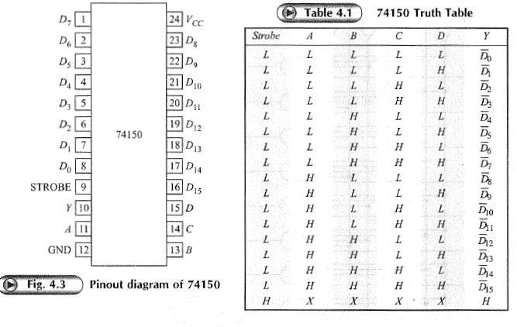
Pin out Diagram 74150
Here in 74150 the output is the complement of selected data bit

Slide 8
End of class

Slide 9
Universal Logic Circuit
Multiplexer sometimes is called universal logic circuit because a 2^{n}-to-l multiplexer can be used as a design solution for any n variable truth table.
This we have seen for realization of a 4 variable truth table by 16-to-l multiplexer.
Here, we show how this truth table can be realized using an 8-to-l multiplexer. Let's consider A,B and C variables to be fed as select inputs.

Slide 10
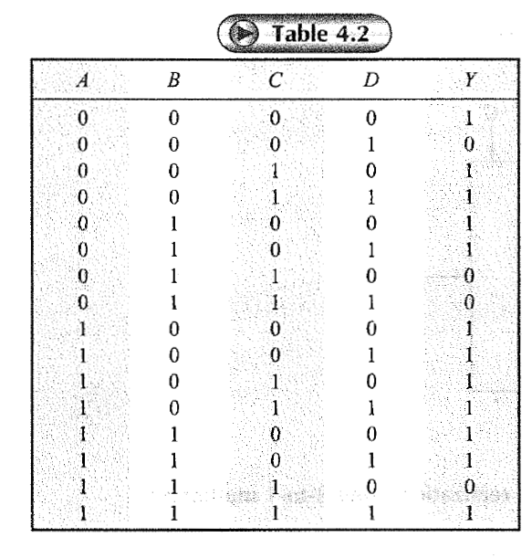
Example to convert MUX 16:1 to 8: 1

Slide 11
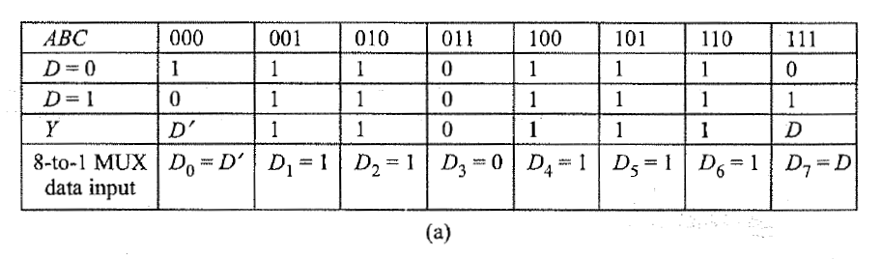
8: 1 MUX

Slide 12
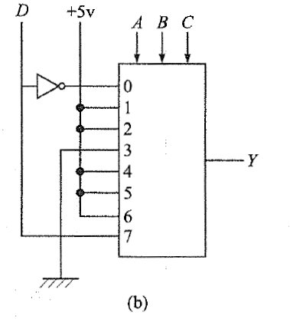
Circuit of 8:1 MUX

Slide 13
Nibble multiplex
Sometimes we want to select one of two input nibbles.
The input nibble on the left is A₃A₂A₁A₀ and the one on the right is B₃B₂B₁B₀.
The control signal labeled SELECT determines which input nibble is transmitted to the output.
When SELECT is low, the four NAND gates on the left are activated; therefore, Y₃Y₂Y₁Y₀ = A₃A₂A₁A₀
When SELECT is high, the four NAND gates on the right are active, and Y₃Y₂Y₁Y₀ = B₃B₂B₁B₀

Slide 14
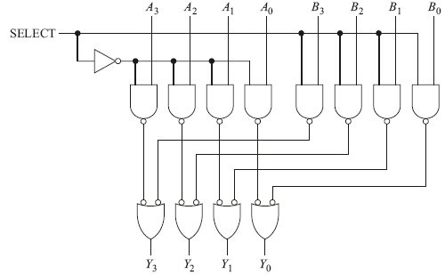
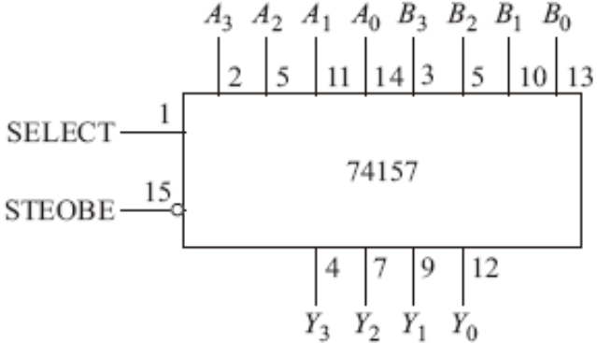
Nibble Multiplexer
Nibble Multiplexer

Slide 15
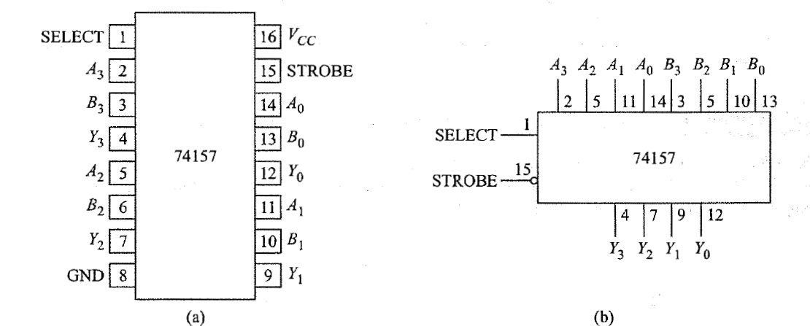
Pinout diagram of 74157

Slide 16
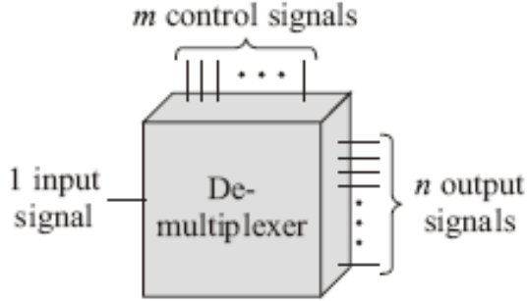
Demultiplexers
Demultiplex means one into many. A demultiplexer is a logic circuit with one input and many outputs.
The 74154 (1-to-16 demultiplexer)

Slide 17
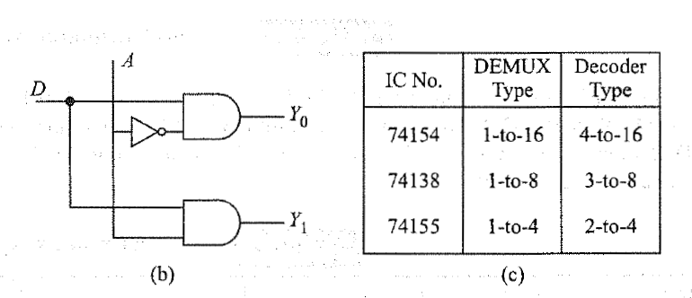
Logic circuit & Commercial ICs

Slide 18
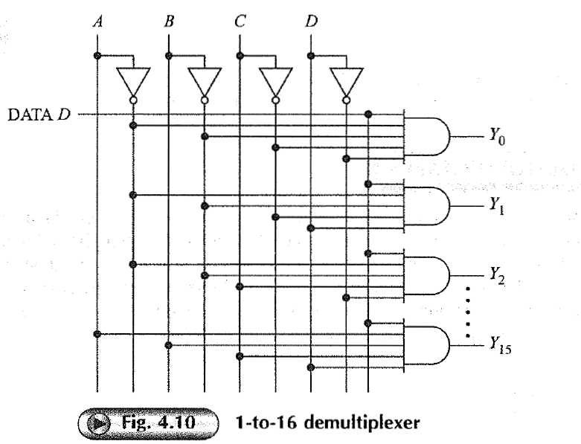
74154 Demultiplexer

Slide 19
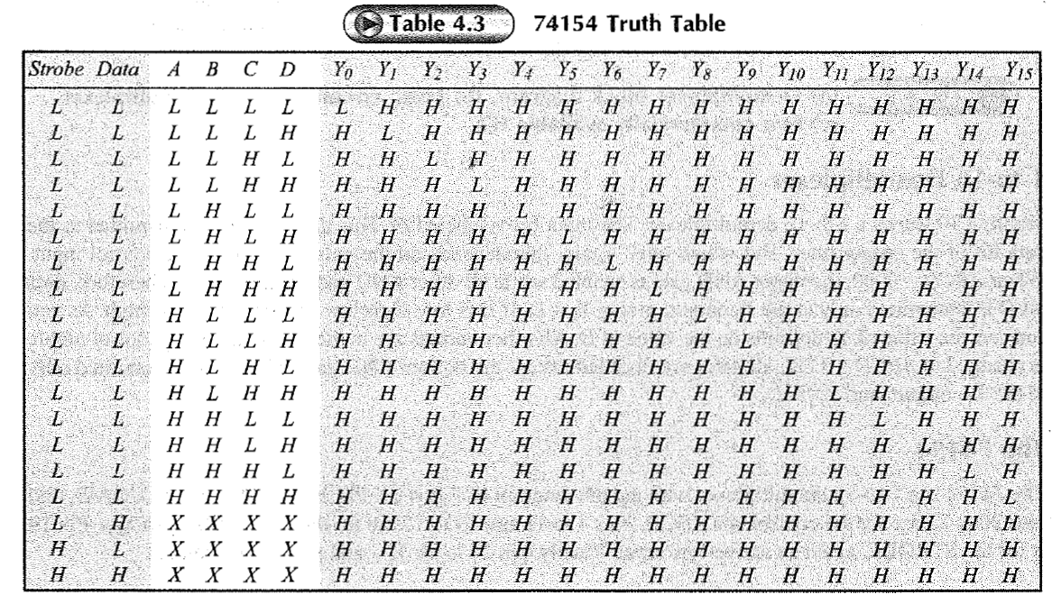

Slide 20
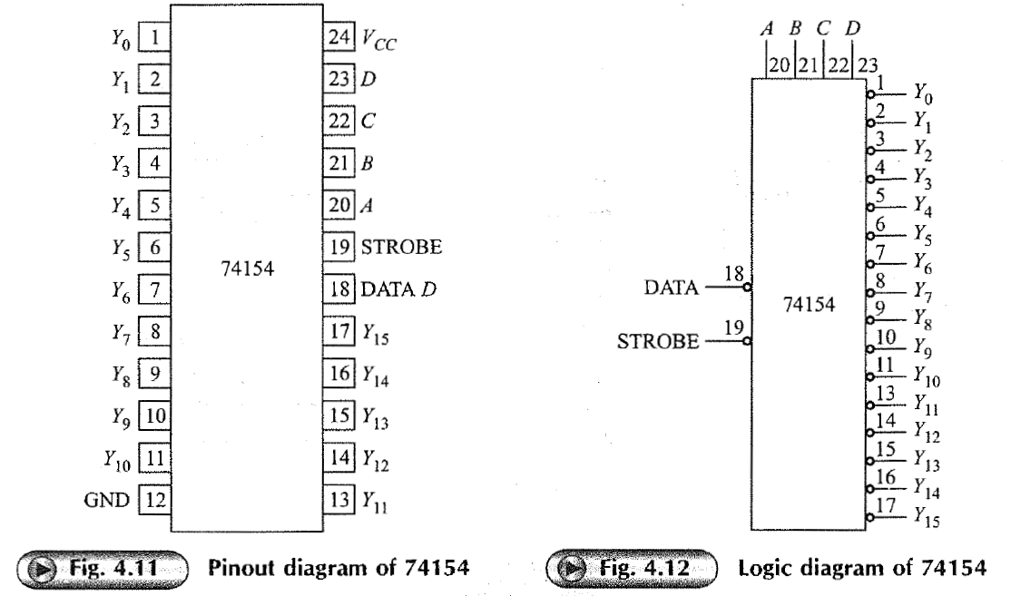
Pinout duagram and logic diagram

Slide 21
End of class

Slide 22
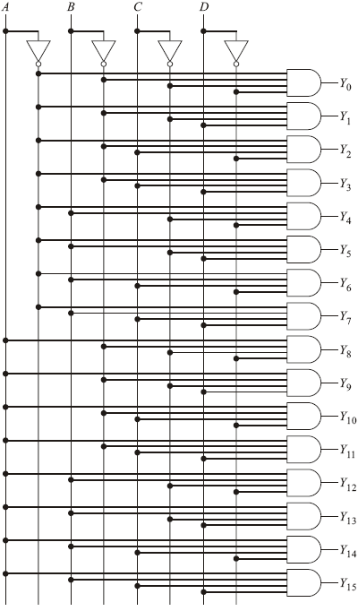
1-of-16 Decoder
A decoder is similar to a demultiplexer, with one exception—there is no data input. The only inputs are the control bits ABCD. This logic circuit is called 1-of-16 decoder because 1 of the 16 output line is high.

Slide 23
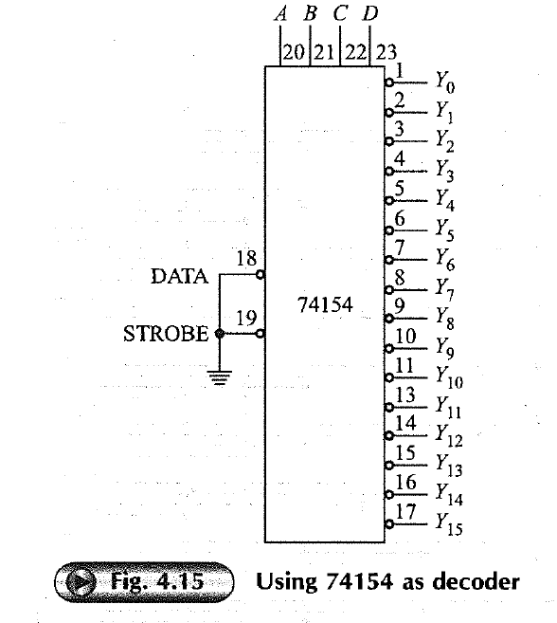
74154 DECODER

Slide 24

Problem -1
Show how using a 3-to-8 decoder and multi-input OR gates following Boolean expressions can be realized simultaneously for,
  F₁(A, B, C) = Σm(0, 4, 6); F₂(A, B, C) = Σm (0,5); F₂(A, B, C) = Σm (l, 2, 3, 7)

Slide 25
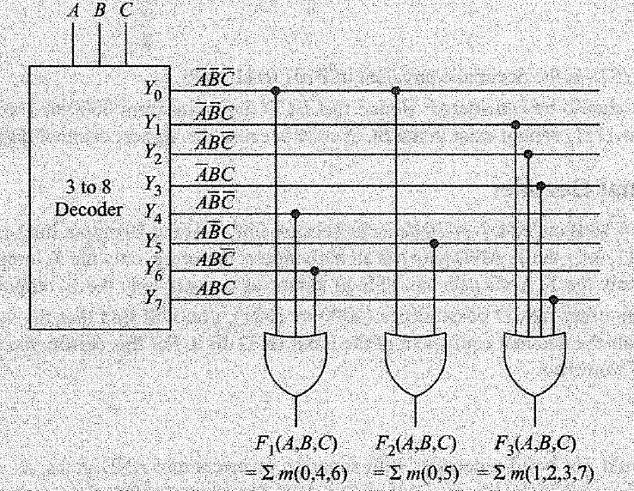
Solution

Slide 26
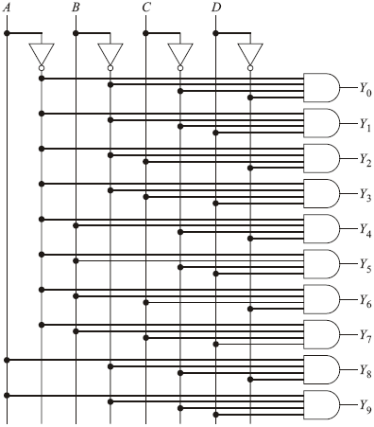
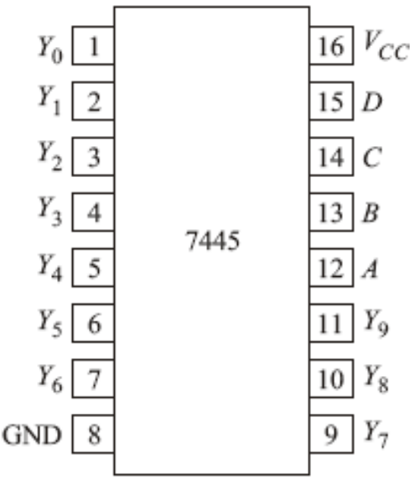
BCD-to-Decimal Decoder
BCD is an abbreviation for binary-coded decimal. The BCD code expresses each digit in a decimal number by its nibble equivalent. To anyone using BCD code, 0100 0010 1001 is equivalent to 429.
Pinout diagram of 7445

Slide 27
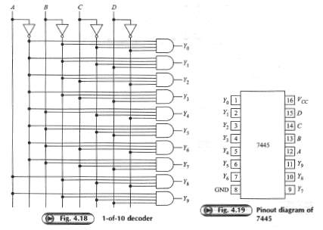
1-to-10 decoder

Slide 28
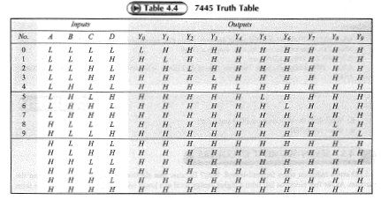
Truth Table 7445

Slide 29
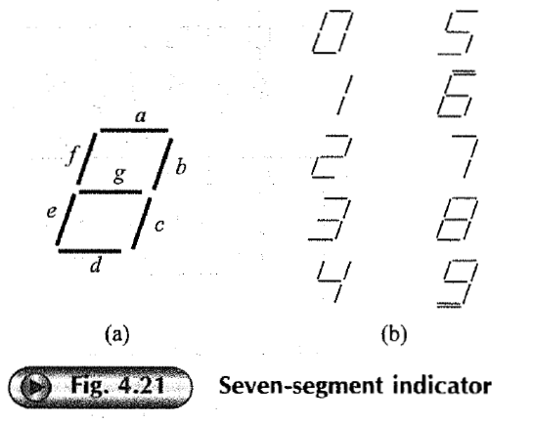
Seven segment decoder

Slide 30
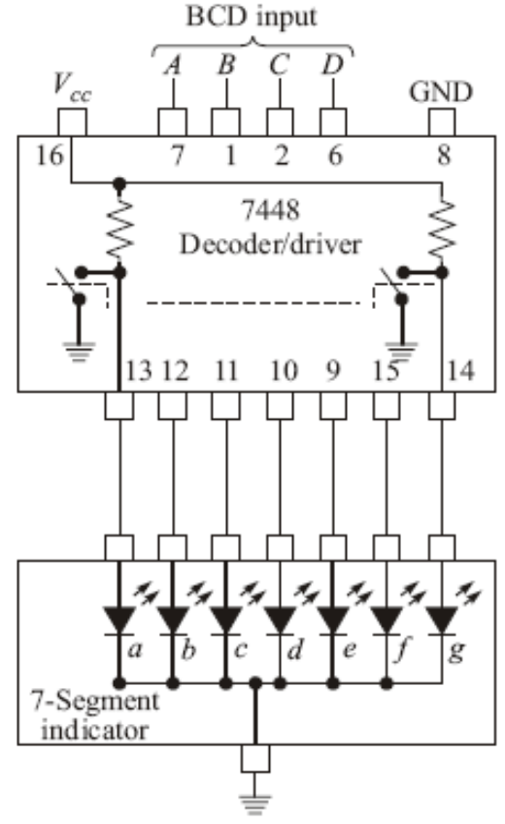
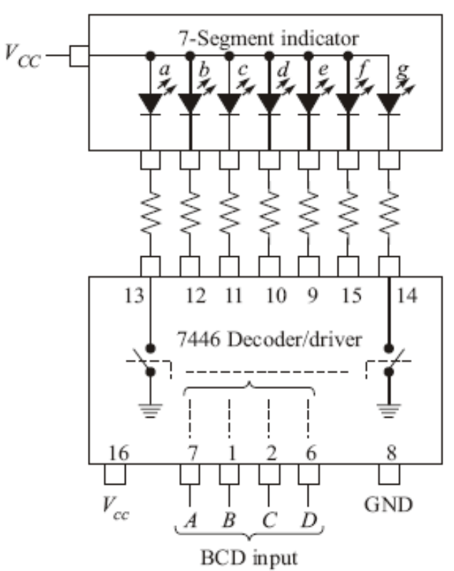
Seven-Segment Decoder
By forward biasing Seven LEDs labeled a through g, we can display the digits 0 through 9.
7446 decoder driver
7448 decoder driver

Slide 31
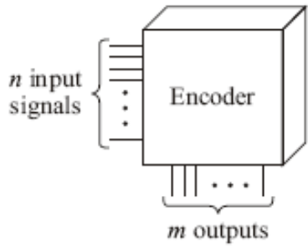
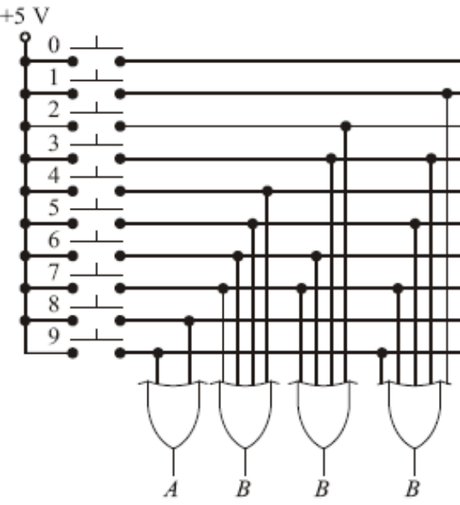
Encoders
An encoder converts an active input signal into a coded output signal.
Decimal-To-BCD Encoder

Slide 32
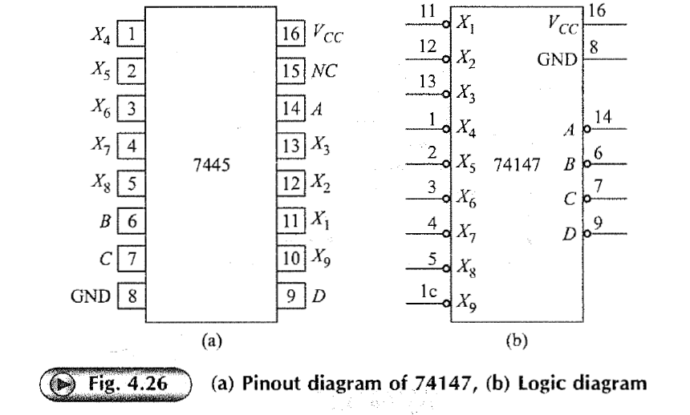
Pin Diagram and Logic diagram

Slide 33
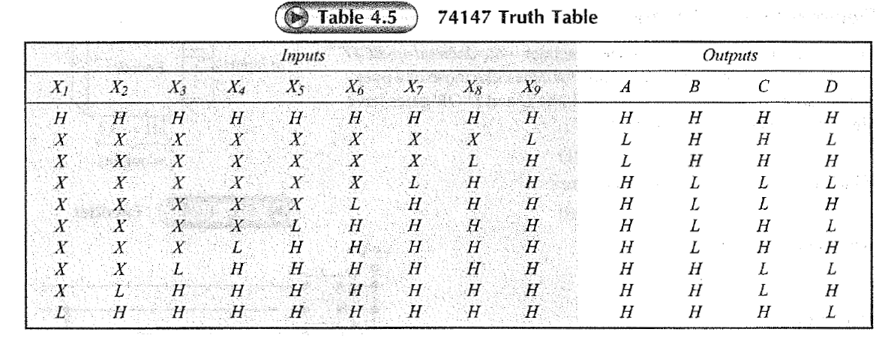
Truth table Encoder

Slide 34
End of class

Slide 35
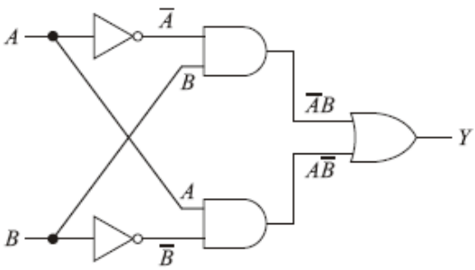

Exclusive-OR Gates
The exclusive-OR gate has a high output only when an odd number of inputs is high.
Y=AB+A B
A 0 0 1 1 | B 0 1 0 1 | Y 0 1 1 0
Logic symbol
XOR gate
Truth Table

Slide 36
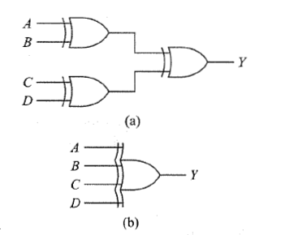
Four inputs X-OR gates

Slide 37
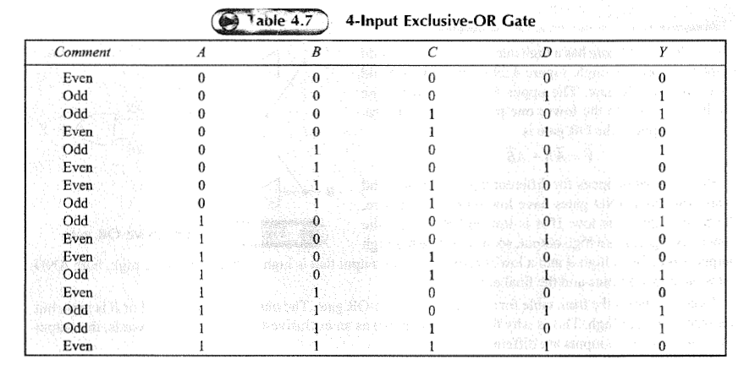
Truth Table for 4-input X-OR gate

Slide 38
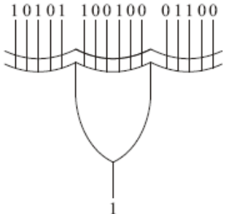
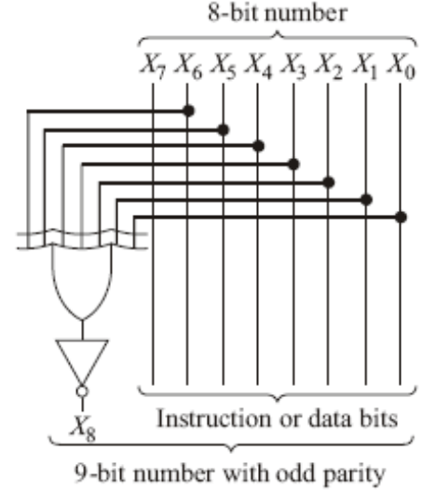
Parity Generator and Checkers
Even parity means an n-bit input has an even numbers of 1s. For instances, 110011. Odd parity means an n-bit input has an odd number of 1s. For instance, 110001.
Parity Checker
Parity Generation
Application
To check data transmission errors

Slide 39
Application
Because of transients, noise, and other disturbances, 1-bit errors sometimes occur when binary data is transmitted over telephone lines or other communication paths.
One way to check for errors is to use an odd-parity generator at the transmitting end and an odd-parity checker at the receiving end.
If no 1-bit errors occur in transmission, the received data will have odd parity.

Slide 40
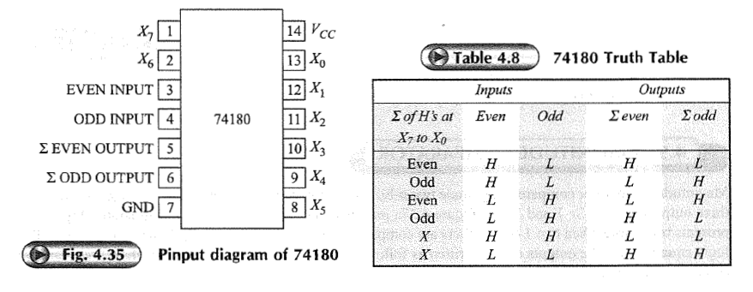
74180 Parity generator checker

Slide 41
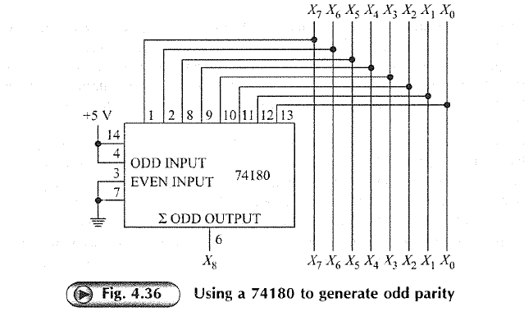
74180 odd parity generated

Slide 42
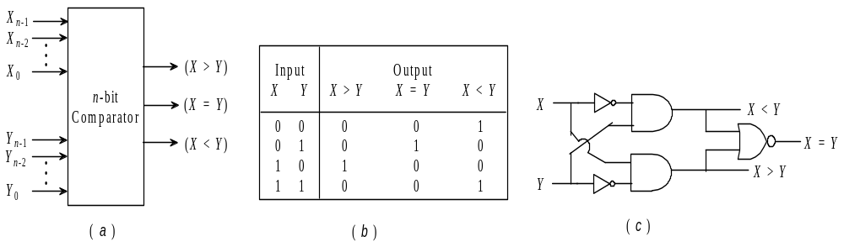

MAGNITUDE COMPARATOR
Magnitude comparator compares magnitude two n-bit binary numbers, say X and Y and activates one of these three outputs X=Y, X>Y and X<Y.
0
a) Block diagram of Magnitude comparator (b)Truth table and (c)circuit for 1-bit comparator

Slide 43
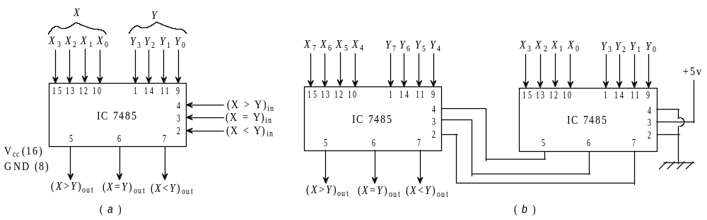
MAGNITUDE COMPARATOR
a) Functional diagram of IC 7485 and (b) 8-bit comparator from two 4-bit comparators.

Slide 44
End of class
Next Class,
ROM

Slide 45
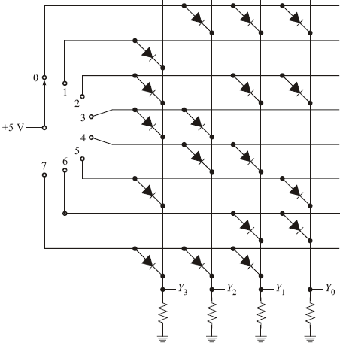
Read-only Memory
A read-only memory is an IC that can store thousands of binary numbers representing computer instructions and other fixed data.
DIODE ROM
    Stores the binary numbers
Address | Nibble
0 1 2 3 4 5 6 7 | 0111 1000 1011 1100 0110 1001 0011 1110
Diode ROM

Slide 46
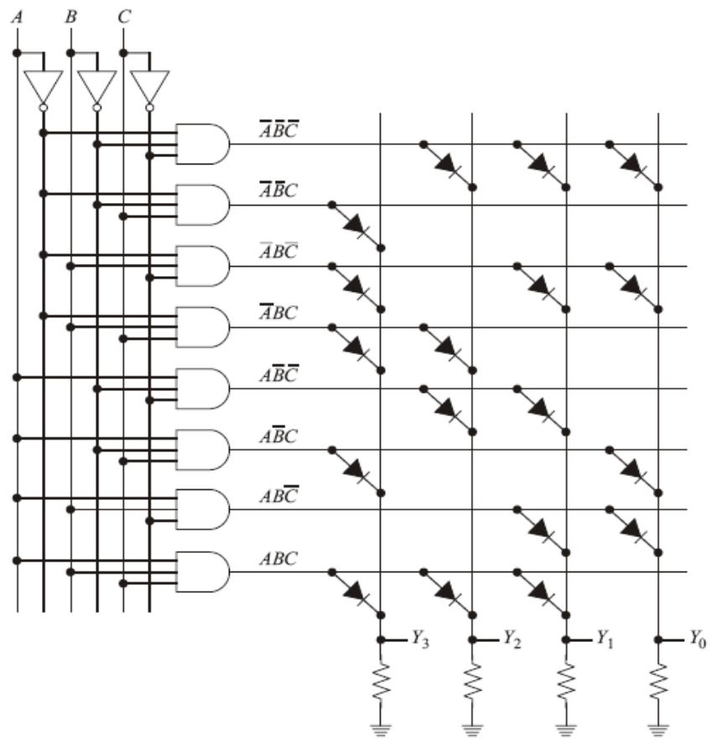
Read-only Memory
On-Chip Decoding
  Rather than switch-select the addresses as shown previously, a manufacturer uses on-chip decoding. With on-chip decoding, n inputs can select 2^{n} memory locations.

Slide 47
Read-only Memory
Commercially Available ROMs
    7488: 256 bits organized as 32 x 8
    74187: 1024 bits organized as 256 x 4
    74S370: 2048 bits organized as 512 x 4
Generating Boolean Functions
Programmable ROMs
  A programmable ROM(PROM) allows the user instead of the manufacturer to store the data.
    74S188: 256 bits organized as 32 x 8
    74S287: 1024 bits organized as 256 X 4
    74S472: 4096 bits organized as 512 X 8

Slide 48
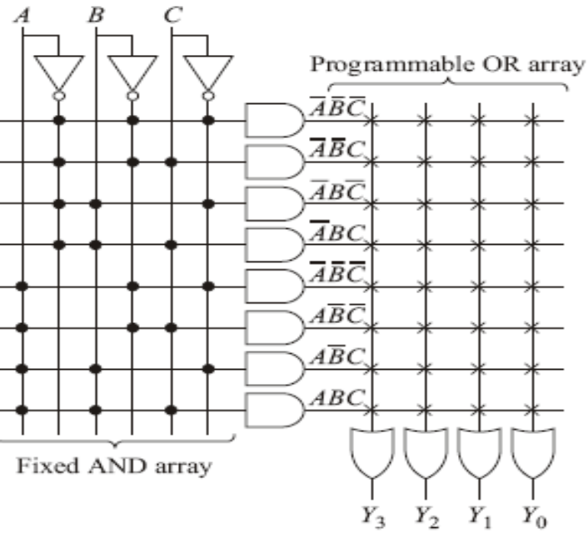
Read-only Memory
Simplified Drawing of a PROM
Programming a PROM
    Generating a Boolean Function at the output of a PROM is accomplished by fusing fusible links at input to OR gates.
Each X is a fusible link that can be removed.

Slide 49
Read-only Memory
Erasable PROMs
  The erasable PROM (EPROM) uses metal-oxide-semiconductor field-effect transistors (MOSFETs). Data is stored with an EPROM programmer. Later, data can be erased with ultraviolet light.
  Some of Commercially available EPROMs:
    2716: 16,384 bits organized as 2048 x 8
    2732: 32,768 bits organized as 4096 x 8
  The EPROM is useful in project development. With an EPROM, the designer can modify the content until the stored data is perfect.

Slide 50
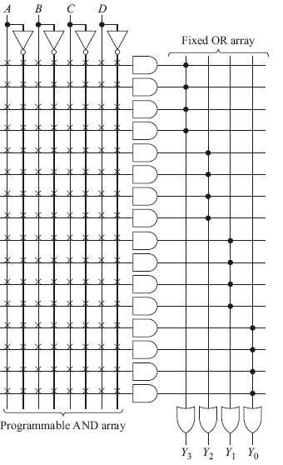
Programmable Array Logic
PAL is a programmable array of logic gates on a single chip.

Slide 51
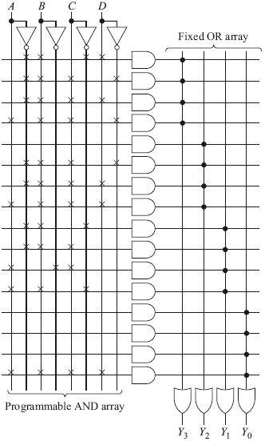
Programmable Array Logic
Programming A PAL
  A PAL is different from a PROM because it has a programmable AND array and a fixed OR array.
Y3=ABCD+ABCD+ABCD+ABCD
Y2=ABCD+ABCD+ABCD
Y1=ABC+ABC+ABC+ABC
Y0=ABCD

Slide 52
Programmable Array Logic
Commercially available PALs
  10H8: 10 input and 8 output AND-OR
  16H2: 6 input and 2 output AND-OR
  14L4: 14 input and 4 output AND-OR-INVERT
  For these chip numbers, H stands for active-high output and L for active-low output.

Slide 53
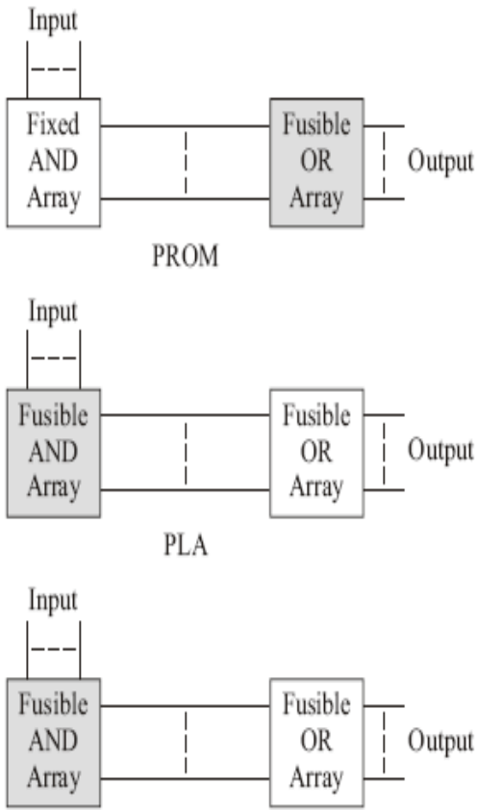
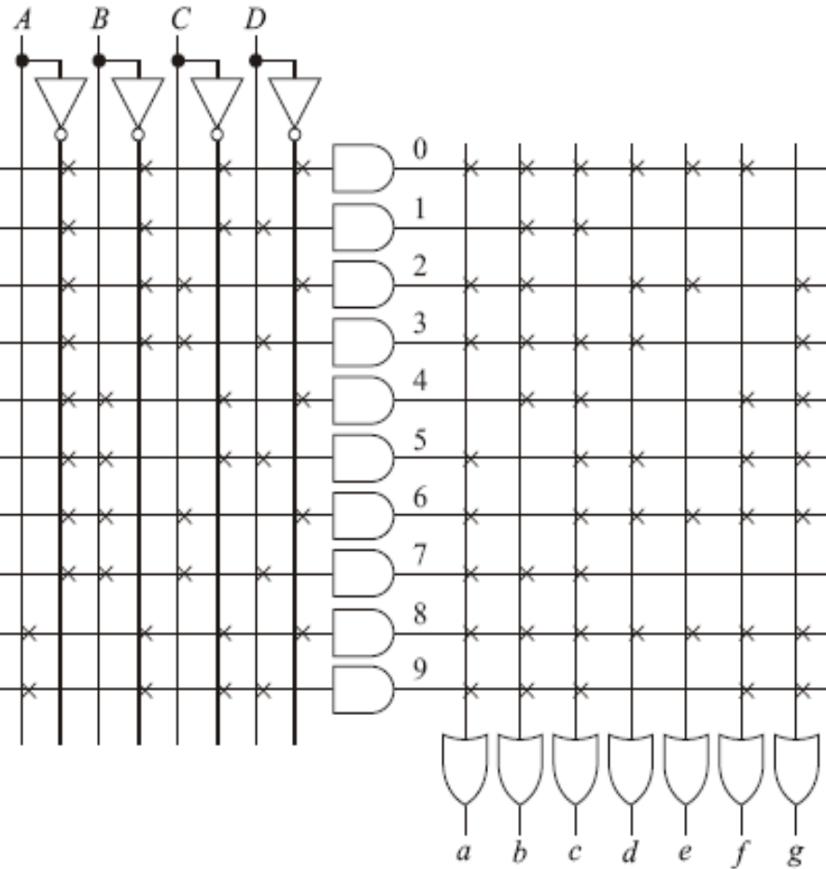
Programmable logic Arrays
PLAs, along with ROMs and PALs, are included in more general classification of ICs called programmable logic devices(PLDs).
PAL
PLA

